Slide 1



Helvetas DECARBONIZATION FUND
Maya Wolfensberger
Senior Advisor Climate Change
May 2024
Notes:
fund that has been created to earmark financial resources to the decarbonization process within HELVETAS.
Short recap to recall what has already been discussed and what the aim of today's discussion is.

Slide 2
System limits of our carbon footprint
Before 2017
2018
2020
2021
2022 …2030
2017
2019
Flights booked via travel desk
Switzerland
(incl flights booked via travel desk)
Mandatory participation for all country offices
Decarbonization Fund based on internal carbon price (introduced in 2023, applied to 2020/2021 retrospectively)
Offsetting (via third parties)
Reverts financial resources back to HELVETAS
Ownership of activities remains with us
Allows reducing emissions at its source
Notes:
We have since long been monitoring the emissions caused by air travel, of those flights booked via the travel desk.
In 2017 we decided to expand the system limits to a full carbon footprint of our Swiss emissions, all emissions that are caused by the energy consumption of our building, electricity, IT equipment, Waste etc.
From 2018 onwards the carbon footprint has been expanded to our country offices, tarting with 4 countries, and then finally in 2022 reaching a complete Carbon footprint of all countries where we maintain offices.
It has also becoe mamndatory for all countries to participate.
So collecting information is one thing, an important starting point, but then what do you do about it. Until 2019 we have been offsetting our emissions, so reduced emissions elsewhere by purchasing carbon credits from third parties.
As this was no longer seen as being a sustainable approach, as it did not follow the mitigation hierarchy which prescriibes that you should reduce your emissions at the source, we completely changed to approach and introduced an intrenal carbon price and created a decarbonization Fund in 2023.

Slide 3
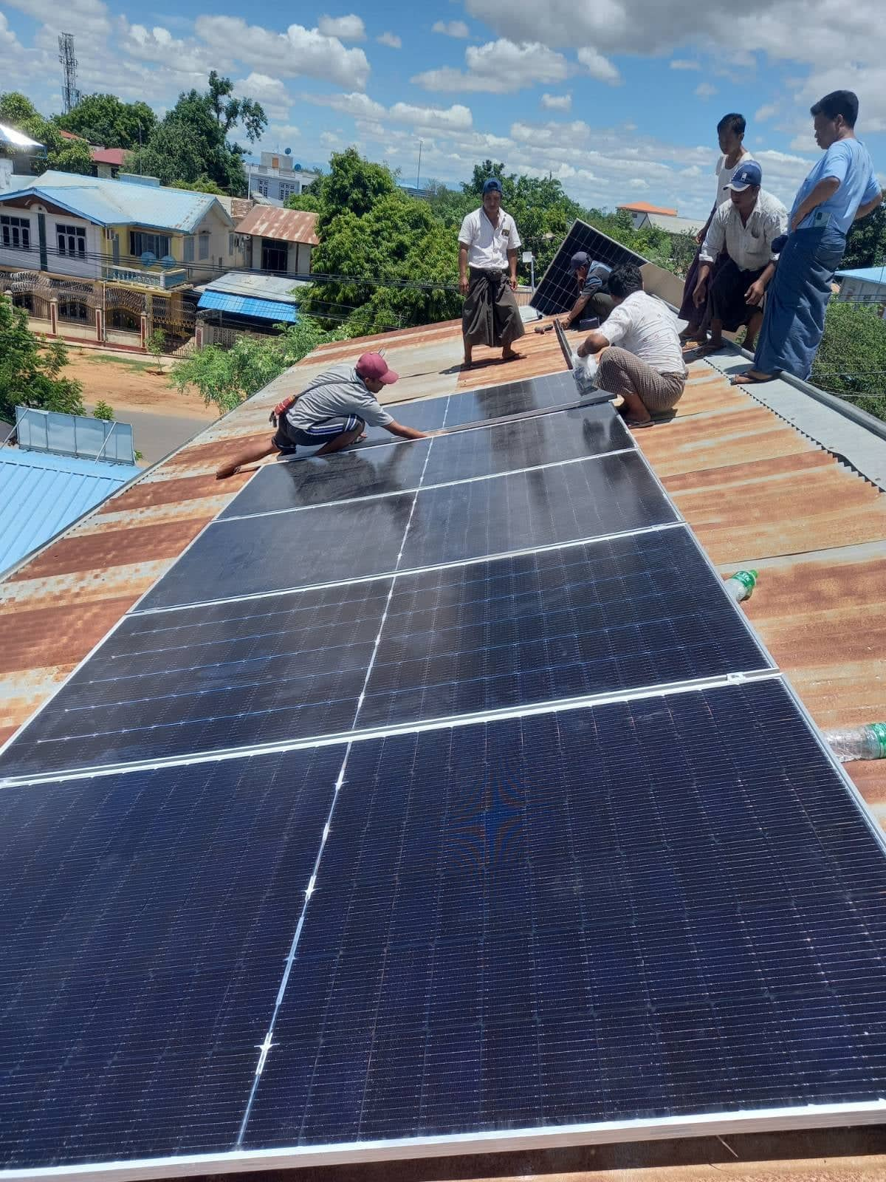


Decarbonization Fund: How does it work?
Helvetas measures its carbon footprint (including all 34 offices worldwide and all 3 scopes)
Reinvestment in emission reduction measures
Country-specific Carbon footprints
Apply Internal Carbon Levy
started at 10 CHF / t CO2e (is raised by 2 CHF per year)
Polluter pays principle:
Costs are debited to the country program budget
Installation of PV Cells in Myanmar
Notes:
How does it work?
Based on the carbon footprint, each country has to make payments to the fund, based on the internal carbon ley, which has been set at 10 CHF and is raised by 2 CHF each year.
Funds are debited to each country program budget. In Switzerland charged to the departments based on the share of flight emissions.
The money in the fund is then used to finance emission reduction measures in our partner countries.

Slide 4

Key Instrument: Decarbonization Action Plans at country level
Instrument to trigger action at country level to reduce emissions.
Country Actions plans include both mandatory measures and voluntary additional measures.
Funding support can be requested from the decarbonization Fund to support additional measures.
Notes:
How does it work?
Provisions to the Fund will be based on the previous’ year’s annual carbon footprint, and an internal price on carbon.
Price of on carbon is at the moment set at 10 chf / t CO₂e, this applies exactly to the costs that we paid to offset emissions before. However, the price of carbon is a flexible instrument and may be increased in the future with the objective to incentivize further emission reductions.
Funds will be debited to each country program budget based on its carbon footprint of the previous year.
So for NEPAL, if the carbon footprint was 518t in 2022, in 2023 the NEPAL Country program will be charged with 5180 CHF.
2 modalities to apply for funding:
The first modality is the The Decarbonization Action Plan, which focuses on avoiding and reducing the emissions of our Carbon Footprint
The Decarbonization innovation Call, under which specific small-scale mitigation projects, linked to HELVETAS activities may be financed, outside of the carbon footprint. This will be introduced in a second steps once all efforts to reduce emission have been taken

Slide 5
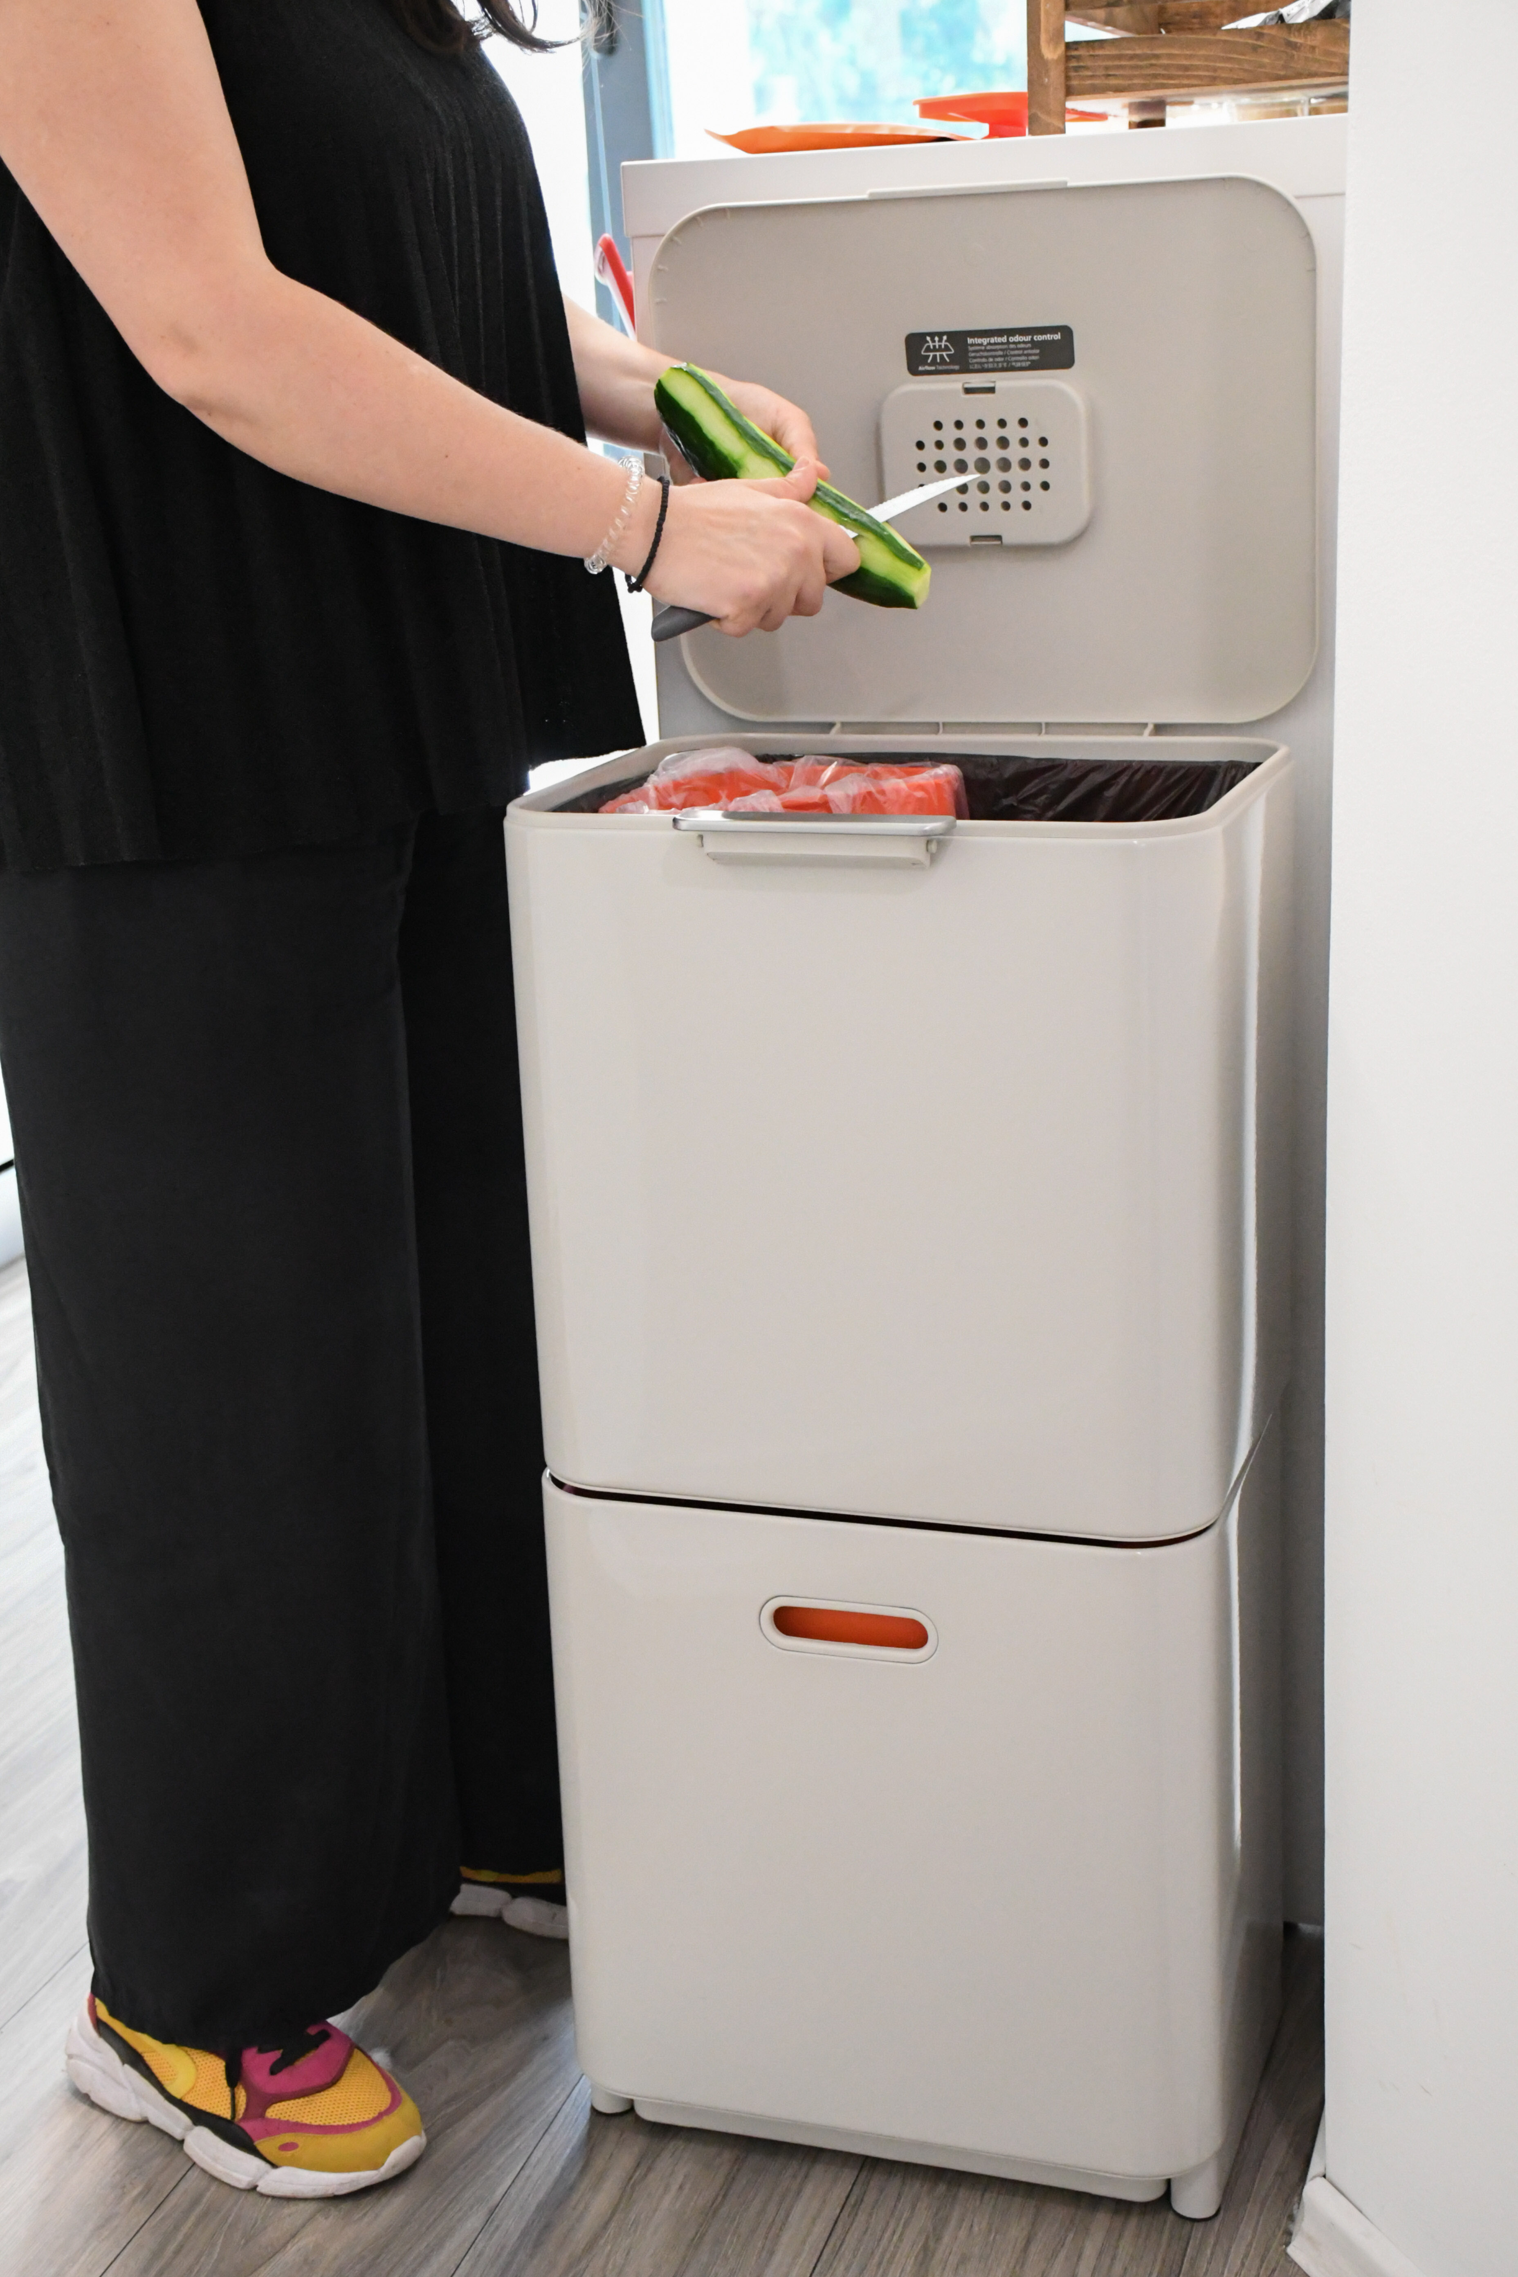
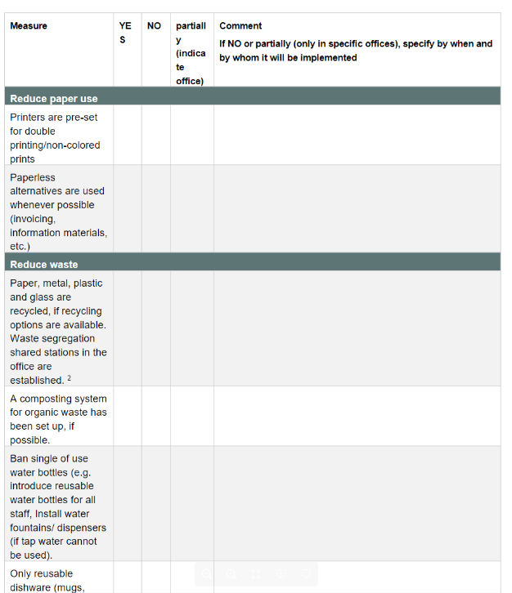
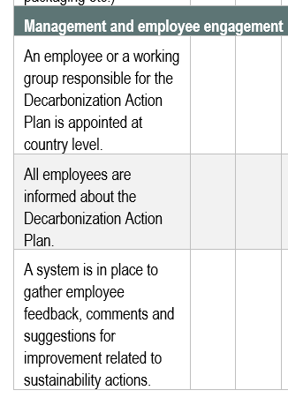
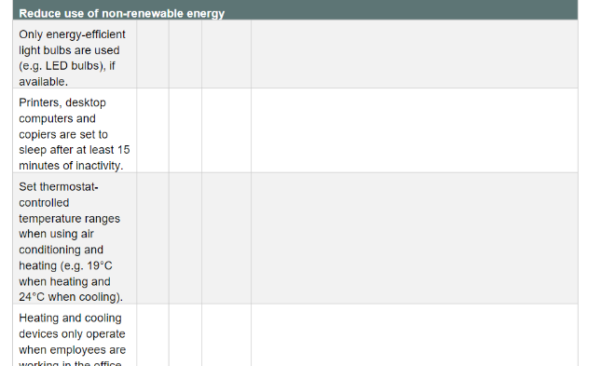
Mandatory measures to greening the office
Checklist of 25 measures
Reduce paper use, waste and water use and use of non-renewable energy use in offices
Procurement of sustainable devices and catering services
Establish working group responsible for the decarbonization Action Plan
Waste separation (Macedonia)
Notes:
First: Which measures are Not eligible to receive funding, A lot of emission reduction measures are actually cost saving or require only minor investments, these are often behavioural measures, we encourage countries to do as far as possible.
The templates provides a checklist with the mandatory measures to me implemented at the level of the different offices; This checklist is based on the Greening_the_office_Checklist by Sida, and includes measures to reduce paper and water use, waste carbon emissions caused by transportation. Sustainable procurement, energy efficiency.
Not all measure are actually mandatory, they have to be adapted to the reality on the ground.
Most importantly, are the measures to engage employees, to establish a working group which is responsible at country level.

Slide 6
Funding for additional measures that require larger up front investments
Selection criteria:
GHG Emission reduction
Further environmental benefits (e.g. indoor air quality, waste and noise reduction)
Social impact (e.g. awareness creation)
Cost-efficiency
Examples
Photovoltaic solar panels to replace generators
Improvement of insulation, ventilation and shading of buildings to reduce need for air conditioning
E-mobility (price difference compared to petrol/ diesel vehicles), charging infrastructure
Energy Audits
Workshops to develop measures in a participatory manner, incentivize behavioral change and create ownership among staff
Installation of solar PV in Myanmar
Win-Win situation: no power cuts anymore and lower electricity bill
Notes:
So what are actually the measures that are eligible to the fund; basically those that require larger up front investments, and would not happen without the fund.
Can be used to co-finance renewable energy systems to replace fossil fuel based electricity production7 cooling systems
To reduce the need for air conditioning, it could also improve insulation, ventilation and shading of buildings
You may need a local energy consultant to make recommendations for energy-efficiency measures
You may even receive funding for Workshops to identify measures in a participatory manner, as this is very important to incentivize behavioral change and create ownership
Countries can suggest their own measures. The criteria are cost-efficiency, they must address the main sources of emissions and should be based on a state-of-the-art technical solution

Slide 7
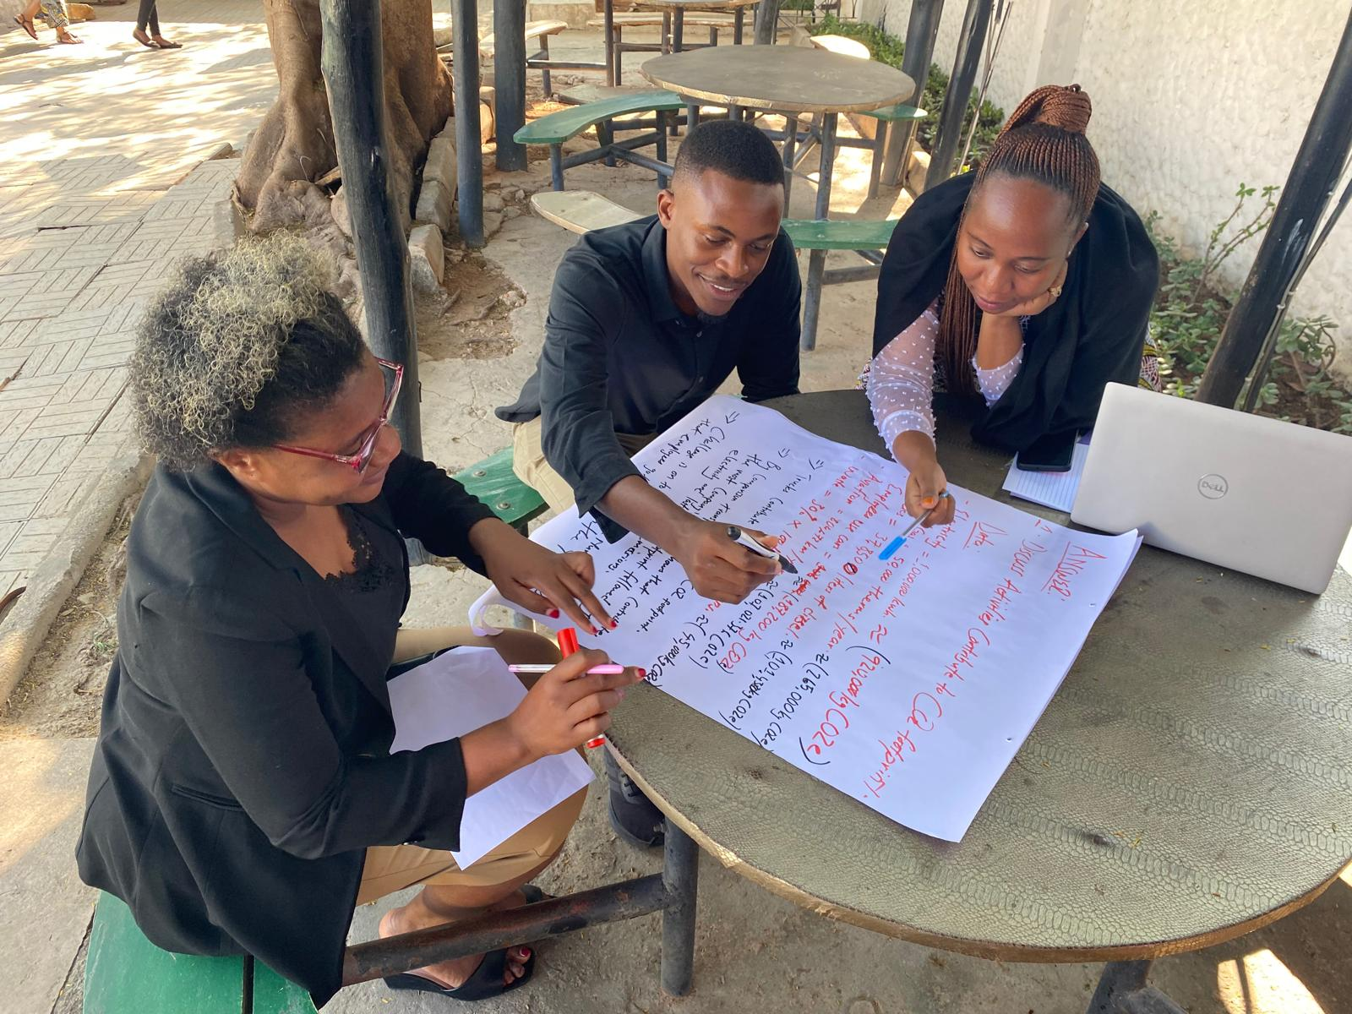
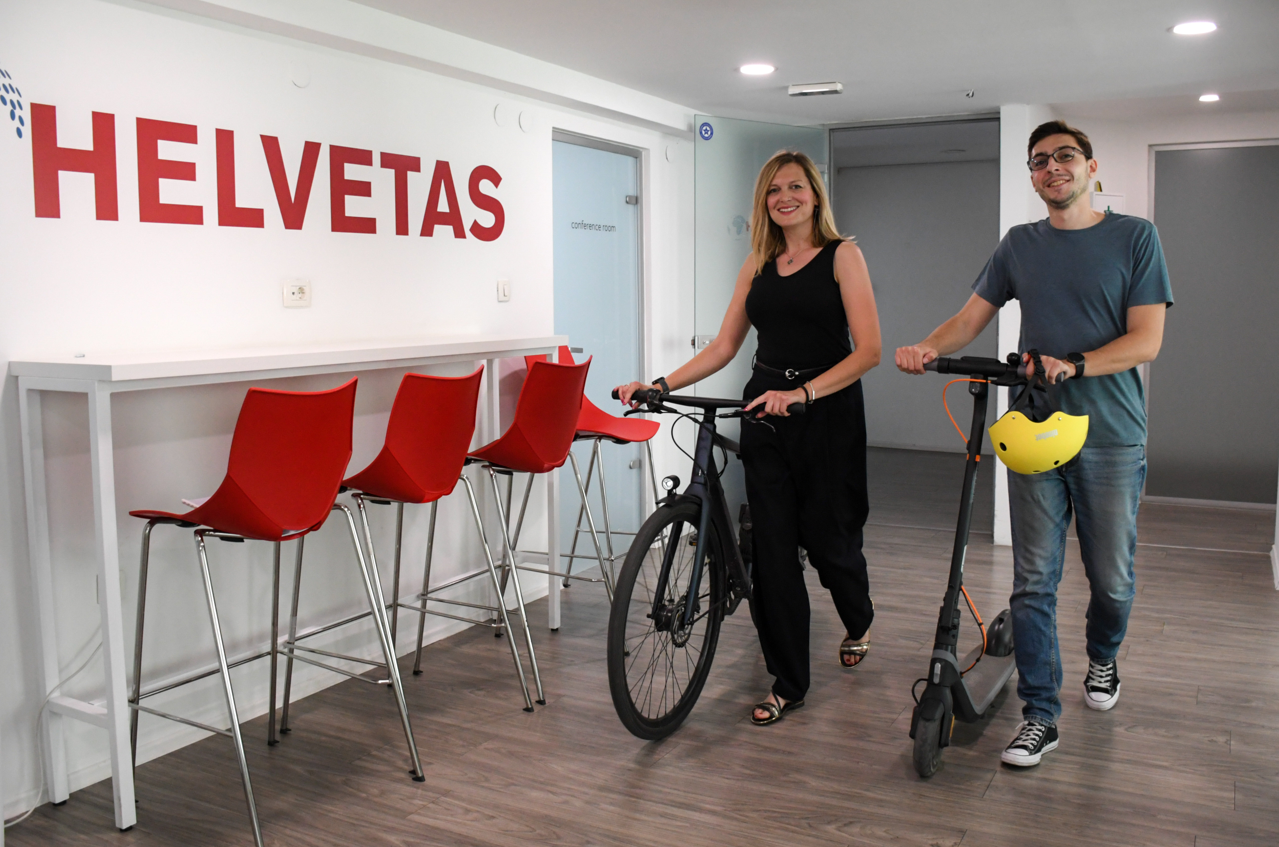

Examples of funded actions 2024
Decarbonization Action Workshop Tanzania
E-Scooter and e-bike in Macedonia
Installation of PV Cells in Myanmar
Notes:
In 2024, 11 Countries have submitted a Decarbonization Action Plan, of which 6 have requested funding for 15 different actions. 14 actions have been selected for funding. The overall granted amount is 65'000 CHF. Among the actions are energy audits, sensitization workshops, Installation of solar PVs, adaptive shading systems, electric motorbikes, subsidies for public transport, and water filtering stations.

Slide 8
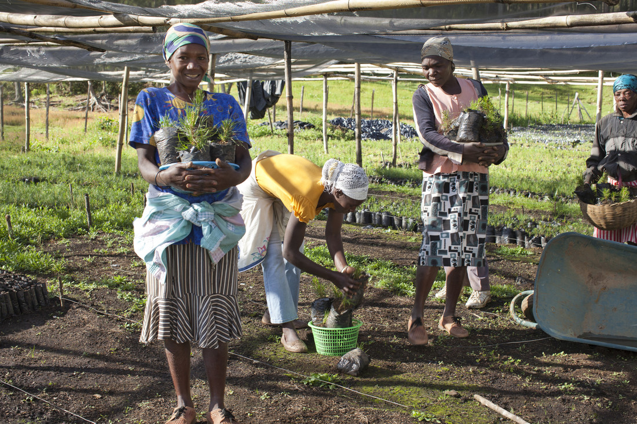

Outlook: Decarbonization Beyond our footprint
Once all reasonable efforts to avoid and reduce emission have been taken, measures beyond our footprint will be supported.
Fund small-scale mitigation projects linked to HELVETAS activities/ beneficiaries
Activities may include:
Restoration / Reforestation activities
Rural electrification
Solar-powered water pumps in small-scale irrigation schemes
small-scale biogas plants for manure
Forestry in Haiti
Notes:
Decarbonization Innovation Call is the second instrument which is not yet operational. It will allow you to submit ideas Fund for measures beyond your carbon footprint emissions and fund small-scale mitigation projects which are some how linked to HELVETAS activities/ beneficiaries.
The idea is to launch it in 2-3 years once we can say that all reasonable efforts to avoid and reduce emission have been taken, so the faster we advance, the faster we can launch it. The participation will be voluntary

Slide 9

THANK
YOU!

