Slide 1
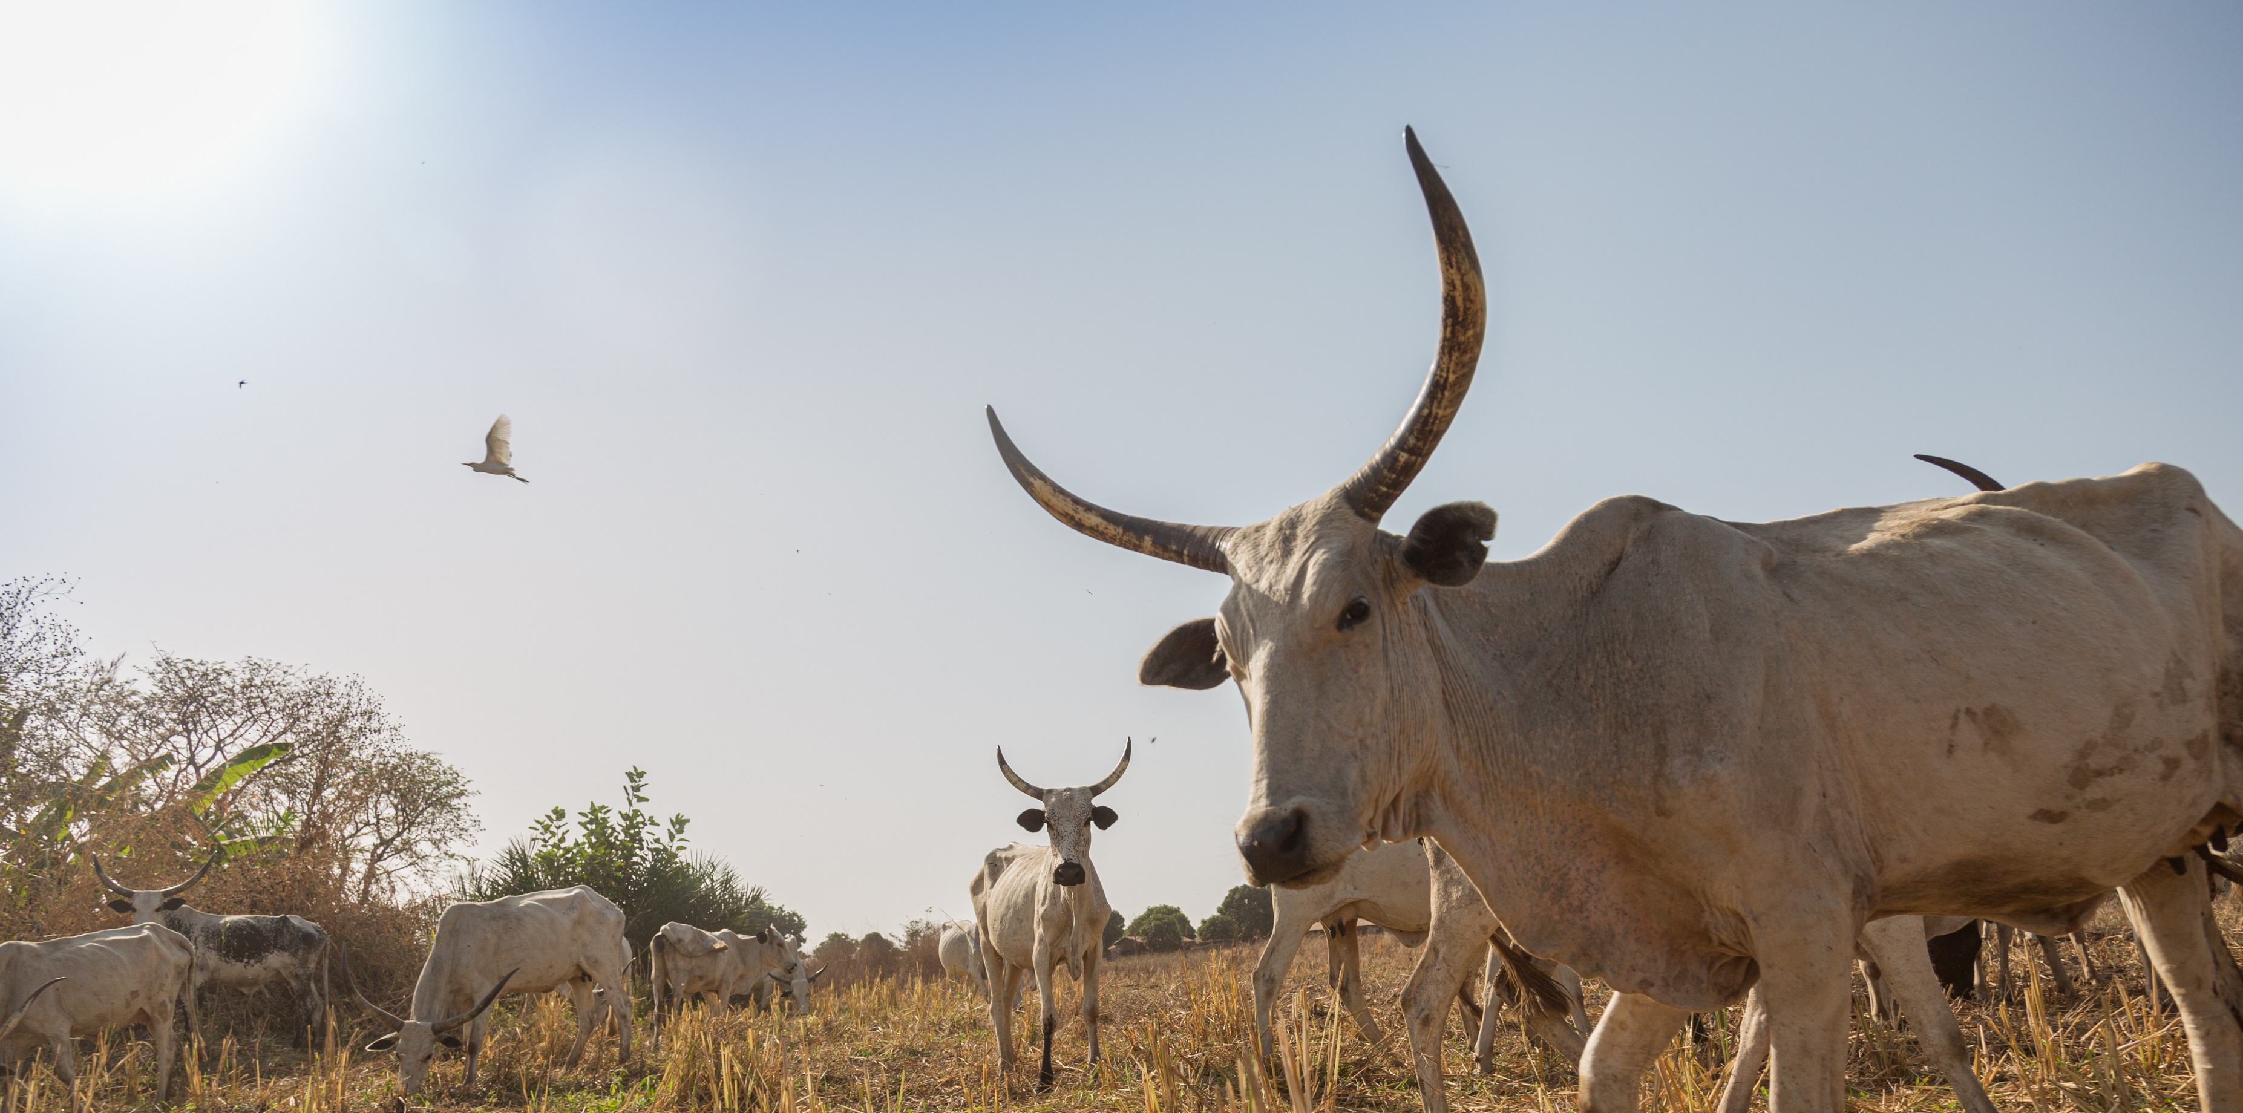

Towards Net Zero
VSF-Suisse case
Dr. Vincent Hug, Programme Director VSF-Suisse
18.06.2024

Slide 2
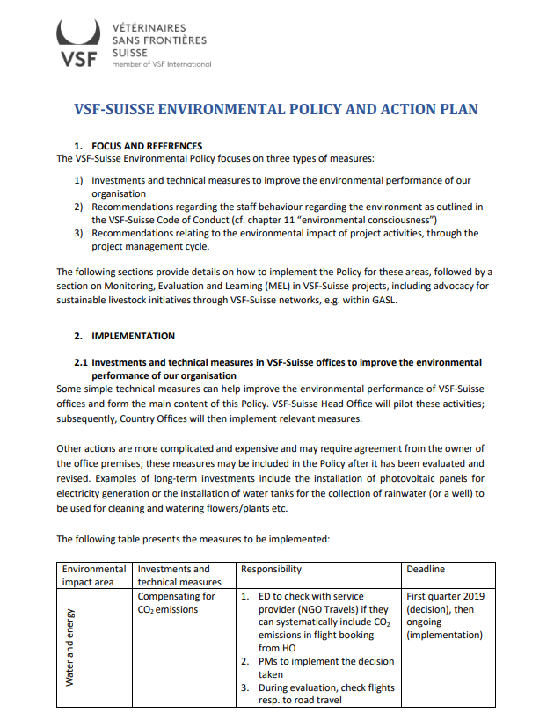
VSF-Suisse environmental policy
Introduced in May 2019
Three impact areas were defined:
Investments and technical measures
Staff/Management behaviors
Project activities/Project cycle

Slide 3
CO2 emissions in comparison to staff/portfolio development

Slide 4
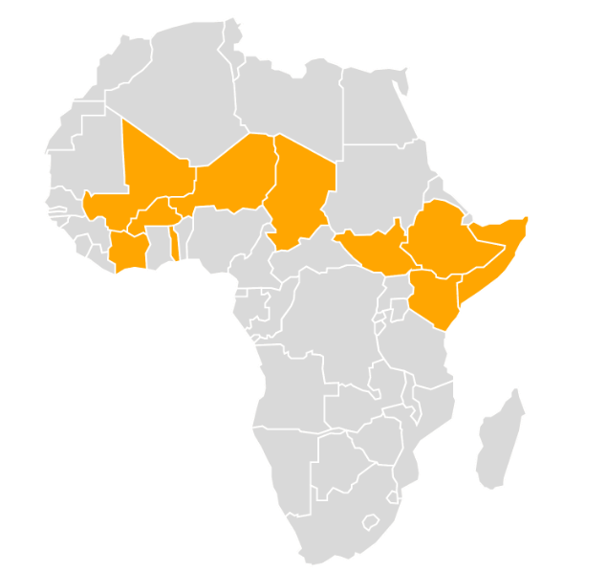
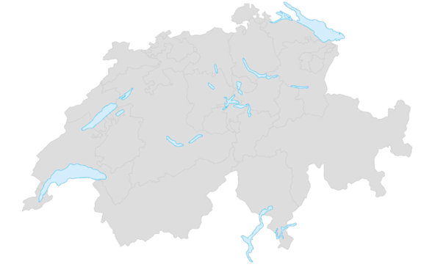
MyClimate survey 2023
South Sudan 75.6t CO2
Mali
128.6 t CO2
Ethiopia
301 t CO2
Suisse HO
19.5t CO2
Kenya and Somalia
112.6 t CO2
Togo
32.9 t CO2

Slide 5
Comparison by category of HO and ETH

Slide 6
Best practices and improvements
Best practices
Improvements
“Paperless” Head Office
Less flights (no flights in Europe)
Solar power in CO – South Sudan started; others will follow
MyClimate – right tool?
How to reduce mobility emissions?
Measuring of environmental impact of project activities
Livestock
Rangeland management
Agroecological practices

Slide 7
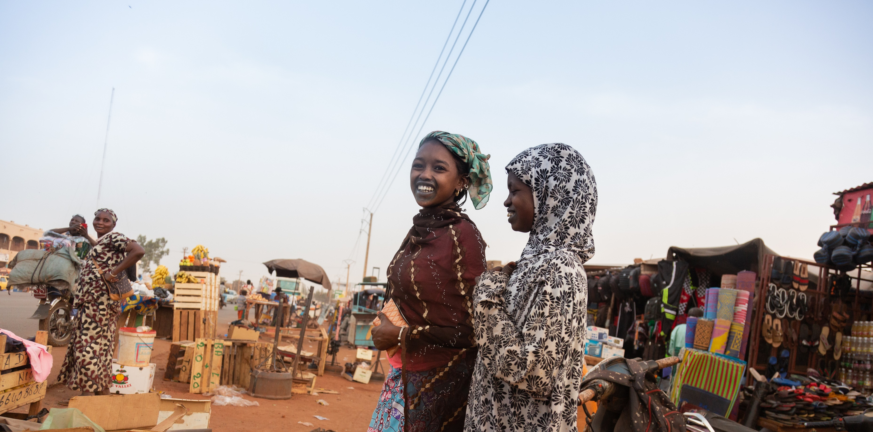
Thank you

